Slide 1
Review 5
Jamie Zhang

Slide 2
Review 5
Internet VS WWW
Structure of URLs(protocol/website address/path/file name)
Website address
http/https
purpose and functions of a web browser

Slide 3
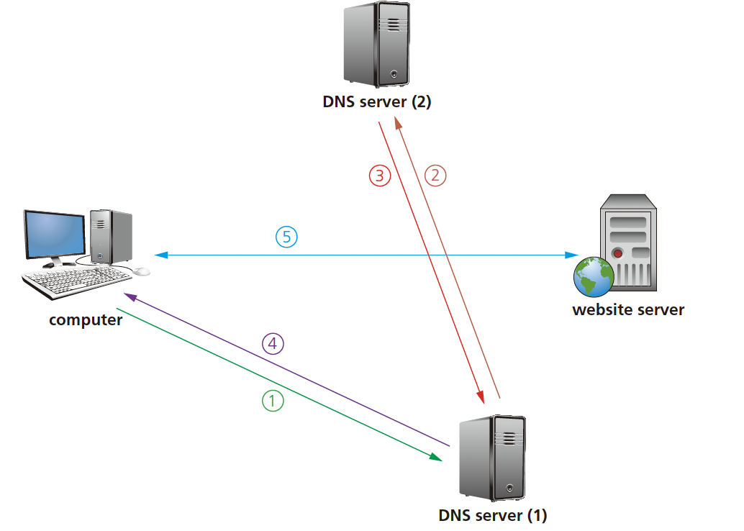
Review 5
How does the DNS server work

Slide 4
Review 5
TLS/SSL handshake
Secure Sockets Layer (SSL) is a type of protocol – a set of rules used by computers to communicate with each other across a network. This allows data to be sent and received securely over the internet.
An SSL certificate is a form of digital certificate which is used to authenticate a website. This means any communication or data exchange between browser and website is secure provided this certificate can be authenticated.

Slide 5
Review 5
cookies: small files or code stored on a user’s computer.
Session cookies: Hence, session cookies cease to exist on a user’s computer once the browser is closed or the website session is terminated. (stored in temporary memory)
Persistent cookies remember a user’s log in details (so that they can authenticate the user’s browser). They are stored on the hard drive of a user’s computer until the expiry date is reached or the user deletes it. Their advantage is that they remove the need to type in login details every time a certain website is visited.

Slide 6
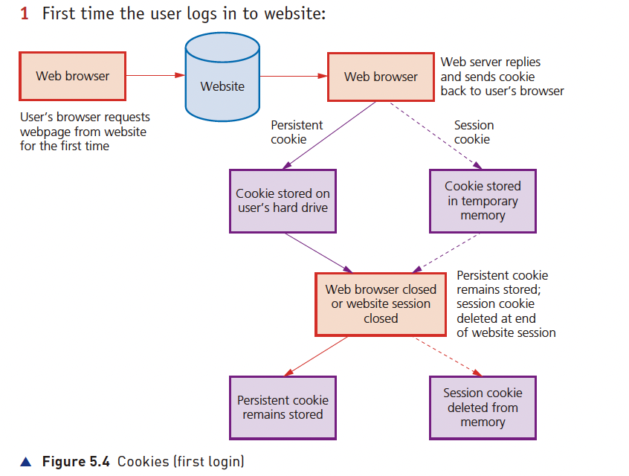
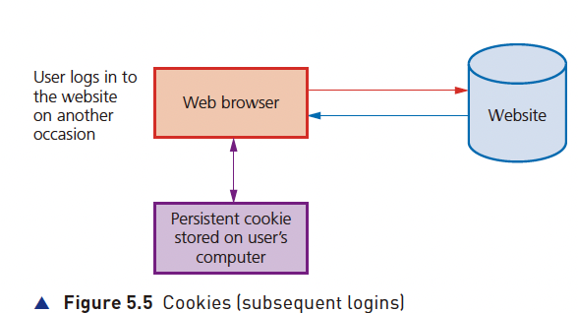
Review 5

Slide 7
Review 5
Digital currency exists purely in a digital format. It relies on a central banking system.
Cryptocurrency is a type of digital currency that works inside a blockchain(decentralizing)

Slide 8
Blockchain
Blockchain is a decentralised database. All the transactions of networked members are stored on this database.
A new hash value is created each time a new block is created. This hash value is unique to each block and includes a timestamp, which identifies when an event actually takes place.

Slide 9
Cybersecurity
brute force attacks
data interception
distributed denial of service (DDoS) attacks
hacking
malware (viruses, worms, Trojan horse, spyware, adware and ransomware)
phishing
pharming
social engineering.

Slide 10
Cybersecurity
Brute force attacks: try all the different combination of letters
Data Interception: Stealing data by tapping into a wired or wireless communication link. (packet sniffing). The use of a wired equivalency privacy (WEP) encryption protocol, together with a firewall, is recommended.
A denial of service (DDoS) attack is an attempt at preventing users from accessing part of a network, notably an internet server.

Slide 11
Cybersecurity
Using an up-to-date malware checker
Setting up a firewall to restrict traffic to and from the web server or user’ computer
Applying email filters to filter out unwanted traffic (for example, spam
There are certain signs a user can look out for to see if they have become a victim of a DDoS attack:
- slow network performance (opening files or accessing certain websites)
- inability to access certain websites
- large amounts of spam email reaching the user’s email account.

Slide 12
Cybersecurity
Hacking is generally the act of gaining illegal access to a computer system without the user’s permission. (malicious and ethical)

Slide 13
Malware
Viruses are programs or program code that replicate (copies themselves) with the intention of deleting or corrupting files, or causing a computer to malfunction.
Worms are a type of stand-alone malware that can self-replicate.
A Trojan horse is a program which is often disguised as legitimate software but with malicious instructions embedded within it.
Spyware Adware Ransomware

Slide 14
Phishing& Pharming
Phishing occurs when a cybercriminal sends out legitimate-looking emails to users.
Pharming is malicious code installed on a user’s computer or on an infected website. The code redirects the user’s browser to a fake website without the user’s knowledge.(DNS cache poisoning)

Slide 15
Social Engineering
Social engineering occurs when a cybercriminal creates a social situation that can lead to a potential victim dropping their guard.

Slide 16
Review 5
In different social network/user account different people might have different access levels
Anti-malware includes anti-virus and anti-spyware

Slide 17
Authentification
Authentication refers to the ability of a user to prove who they are.
- something you know (for example, a password or PIN code)
- something you have (for example, a mobile phone or tablet)
- something which is unique to you (for example, biometrics)
Password should be: strong enough, not easy to crack and changed regularly.

Slide 18
Biometric
Biometrics can be used in much the same way as passwords as a way of identifying a user. Biometrics relies on certain unique characteristics of human beings; examples include:
- fingerprint scans
- retina scans
- face recognition
- voice recognition

Slide 19
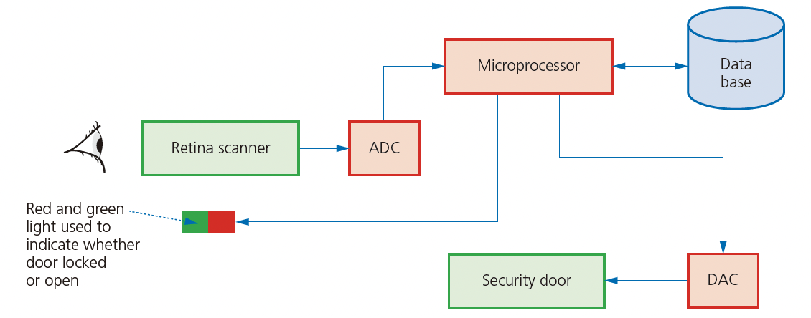
Automatic door system

Slide 20
Two-way authentification
Two-step verification requires two methods of authentication to verify who a user is. It is used predominantly when a user makes an online purchase using a credit/debit card as payment method.
For example, username/password and PIN.
Automatic software updates mean software on computers and mobile phones/tablets is kept up-to-date.
When receiving an email, check out the spelling, tone and email address... Be aware of typo squatting

Slide 21
Review 5
A firewall can be either software or hardware. It sits between the user’ computer and an external network (for example, the internet) and filters information in and out of the computer.
The main tasks carried out by a firewall include:
- to examine the ‘traffic’ between user’s computer (or internal network) and a public network (for example, the internet)
- checks whether incoming or outgoing data meets a given set of criteria
- if the data fails the criteria, the firewall will block the ‘traffic’ and give the user (or network manager) a warning
- the firewall can be used to log all incoming and outgoing ‘traffic’ to allow later interrogation by the user (or network manager)
- criteria can be set so that the firewall prevents access to certain undesirable sites; the firewall can keep a list of all undesirable IP addresses
- it is possible for firewalls to help prevent viruses or hackers entering the user’s computer (or internal network)

Slide 22
Proxy Server
Proxy servers act as an intermediate between the user and a web server
Allow the internet traffics to be filtered.
Keep the users’ IP address secret
Prevent direct access to the web server
If an attack is launched, the proxy server is hit
Used to direct invalid traffics away, thus protecting the web server

Slide 23
Privacy Settings
Privacy settings are the controls available on web browsers, social networks and other websites that are designed to limit who can access and see a user’personal profile.
-a ‘do not track’ setting;
-a check to see if payment methods have been saved on websites;
-safer browsing;
-web browser privacy options；
-website advertising opt-outs;
-apps; for instance, the sharing of location data in map apps can be switched off.

Slide 24
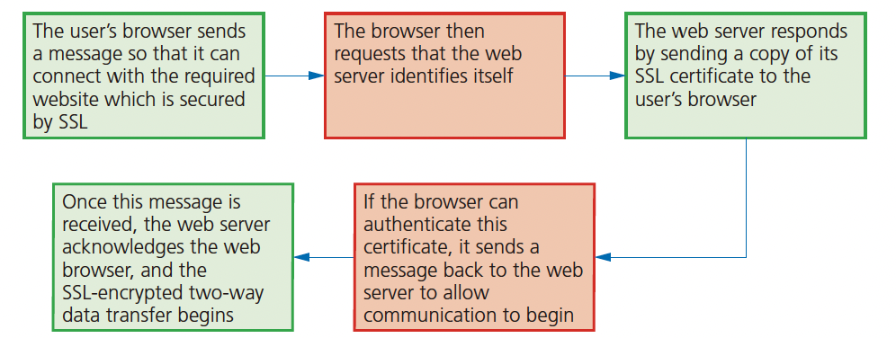
SSL

